Slide 1

FABRICATION OF MECHANICAL SCISSOR JACK TO ELECTRIC SCISSOR JACK
PRESENTED BY:
M.Nidish (927621BME323)
M.NAVEEN (927621BME322) GUIDED BY:
N.NAVEEN KUMAR (927621BME321) MR.M.DHIVIYANATHAN.ME

Slide 2
CONTENT:
Abstract,
Problem Identification,
Introduction,
Methodology,
Block Diagram,
Objectives,
Working Principle,
Advantages,
References.

Slide 3
Abstract:
The scissor jack apparatus uses electrical power to elevate an automobile with a cigar lighter plug of an auto to power the high torque electric motor of the apparatus.
The motor is in communication with the scissor jack via the gear reduction member so that maximum torque is applied to the scissor jack.
The gear reduction drive and the scissor jack ensures against excessive or premature wear, failure, and danger to an operator.
By avoiding any jack encasement, the apparatus provides for inexpensive multiple jack size utilization.

Slide 4
PROBLEM IDENTIFCATION:
The most common problem encountered while using scissor jack is the instability of jack while giving jerks to loosen the wheel nut.
Also the common jack having small base is unable to provide proper support on uneven surface esp.
Off-road and no inclination in that jack is tolerable.

Slide 5
Introduction:
Jack is a device for lifting heavy objects, specially for raising the axle of a motor vehicle off the ground to repair or inspect underside of the vehicle.
Scissor jack is the most common form of different types of jacks.
In this project I have designed and constructed a scissor jack, and simplified it's construction.
The system is further improved by making it motorized so user does not need to operate it manually but just press a button for lifting and lowering it.

Slide 6
Methodology:
Scissor jack is mechanical equipment used to lift up heavy loads.
After rotating the crank, the screw jack rotates and acts like a gear mechanism. The lifting section consists of arms.
The turning of screw operates the arms in such a way that it lifts up very gently. Now the arm rotates very gently and force needed to lift
Thus it allows us to life heavy loads like cars by just using human strength, also the system.

Slide 7
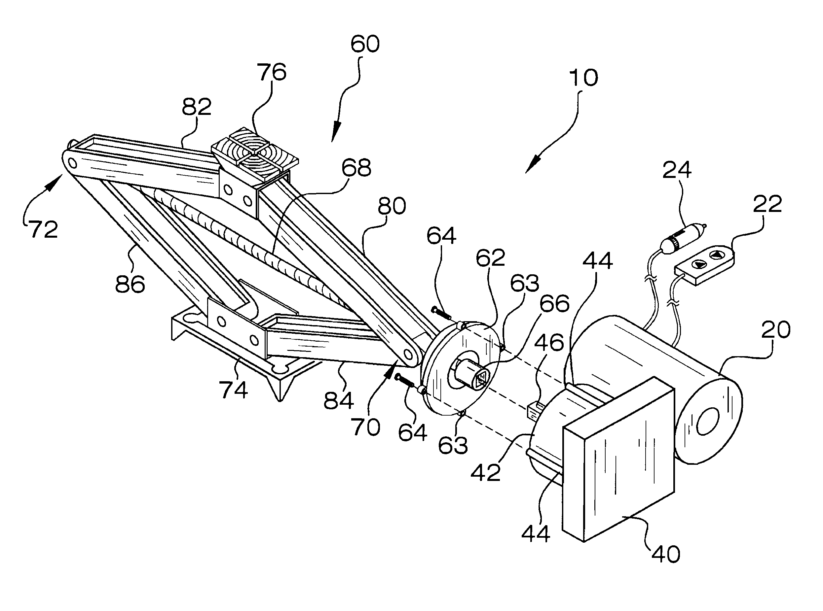
BLOCK DIAGRAM:

Slide 8
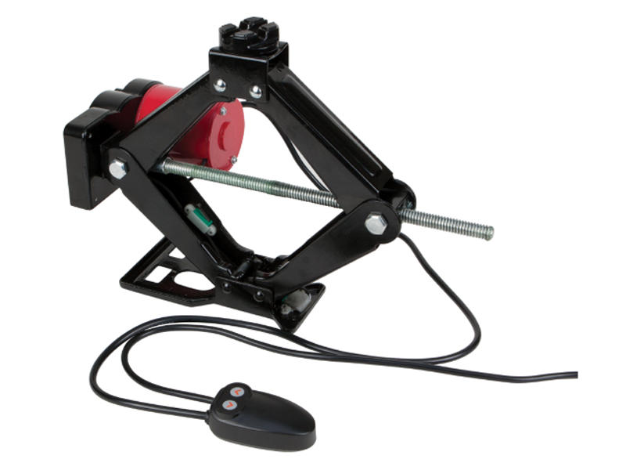

Slide 9
OBJECTIVES:
To lift a heavy vehicle from the ground for changing the wheel and for maintenance purpose.
To design a scissor jack.
To construct a scissor jack.
To simplify the construction.

Slide 10
WORKING PRINCIPLE:
A scissor jack is an example of a power screw in which a small force applied in a horizontal plane is used to raise or lower a large load.
The principle on which it works is similar to that of an inclined plane.
The mechanical advantage of a screw jack is the ratio of the load applied to the effort applied.
The amount of force being applied is multiplied.

Slide 11
ADVANTAGES:
A scissor jack is lightweight.
It also has a simple-to-use design, needing only a crank and some elbow grease to get a strong, solid lift of up to 1.5 tons.
It is easy to handle.
It is help to aged people.
Easy to carry.

Slide 12
REFERENCES:
Robert L.Boylestad “Electronic devices and circuits, 2009.
Rodriguez, Daniel G \"Automatic Jacking System for an Automotive Vehicle, 2006.
M.M. Noor, K. Kadirgama and M.M. Rahman, “Analysis of Auto Car Jack”, National Conference in Mechanical Engineering Research.
“Highly Efficient Motorized Screw Jack, International Journal of Computational Engineering Research”, 3 May 2013.

Slide 13


